Slide 1

INSTITUTE: UIE (AIT-CSE)
Computer Networks CST- 348
Lecture – 1.10 ,1.11 And Lecture-1.12
Data Link layer Functions,services provided to network layer, Error Detection and Correction-Hamming code, CRC, Parity, Checksum,
By : Dr. Monica Luthra(e9836)
DISCOVER . LEARN . EMPOWER

Slide 2

Course Objectives
CO Number | Title
CO1 | Describe the important networking concepts
CO2 | Understand concept of network reference models and protocols
CO3 | Apply the concepts of routing algorithms on various networks
CO4 | Identify mechanism to handle traffic and control on congestion
CO5 | Identify and understand connection establishment techniques and features

Slide 3

Course Outcomes
After this course student will be able to:
To bring together several key of Computer network design and architecture
To Familiarize the student with the basic taxonomy and terminology of the computer networking area.
To Allow the student to gain expertise in some specific areas of networking such as the design and maintenance of individual networks.

Slide 4

Data Link Layer
Data link layer works between two hosts which are directly connected in some sense. This direct connection could be point to point or broadcast. Systems on broadcast network are said to be on same link. The work of data link layer tends to get more complex when it is dealing with multiple hosts on single collision domain.
Data link layer has two sub-layers:
Logical Link Control: It deals with protocols, flow-control, and error control
Media Access Control: It deals with actual control of media

Slide 5
Functionality of Data-link Layer
Framing
Addressing
Synchronization
Error Control
Flow Control
Multi-Access

Slide 6



Types of Errors
There may be three types of errors:
Single bit error
Multiple bits error
Burst error
Image Source : https://www.tutorialspoint.com/data_communication_computer_network/error_detection_and_correction.htm

Slide 7

Error Detection
Parity Check
One extra bit is sent along with the original bits to make number of 1s either even in case of even parity, or odd in case of odd parity.
The sender while creating a frame counts the number of 1s in it. For example, if even parity is used and number of 1s is even then one bit with value 0 is added.
This way number of 1s remains even.If the number of 1s is odd, to make it even a bit with value 1 is added.
Image Source : https://www.tutorialspoint.com/data_communication_computer_network/error_detection_and_correction.htm

Slide 8
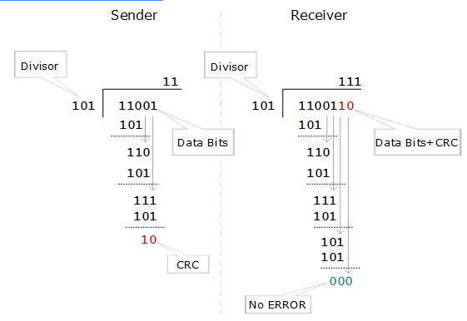
Cyclic Redundancy Check (CRC)
CRC is a different approach to detect if the received frame contains valid data.
This technique involves binary division of the data bits being sent. The divisor is generated using polynomials.
The sender performs a division operation on the bits being sent and calculates the remainder.
Before sending the actual bits, the sender adds the remainder at the end of the actual bits. Actual data bits plus the remainder is called a codeword.
The sender transmits data bits as codewords.
Image Source : https://www.tutorialspoint.com/data_communication_computer_network/error_detection_and_correction.htm

Slide 9
Checksum
Checksum
In this error detection scheme, the following procedure is applied
Data is divided into fixed sized frames or segments.
The sender adds the segments using 1’s complement arithmetic to get the sum. It then complements the sum to get the checksum and sends it along with the data frames.
The receiver adds the incoming segments along with the checksum using 1’s complement arithmetic to get the sum and then complements it.
If the result is zero, the received frames are accepted; otherwise, they are discarded.

Slide 10
Hamming code
Hamming code is a liner code that is useful for error detection up to two immediate bit errors. It is capable of single-bit errors.
In Hamming code, the source encodes the message by adding redundant bits in the message. These redundant bits are mostly inserted and generated at certain positions in the message to accomplish error detection and correction process.
The process used by the sender to encode the message includes the following three steps:
Calculation of total numbers of redundant bits.
Checking the position of the redundant bits.
Lastly, calculating the values of these redundant bits.

Slide 11
Key Points
Circuit switching and multiplexing hardware control of multiplexed digital signals.
A modem [Modulator -Demodulator] is a device.
Multiplexing is the sharing of a medium or bandwidth.
Modulates the process of converting a signal from one form to another so that it can be physically transmitted over a communication channel

Slide 12
References
https://www.geeksforgeeks.org/basics-computer-networking/
https://www.youtube.com/watch?v=VwN91x5i25g&list=PLBlnK6fEyqRgMCUAG0XRw78UA8qnv6jEx
http://www.svecw.edu.in/Docs%5CCSECNLNotes2013.pdf
https://www.cloudflare.com/learning/ddos/glossary/open-systems-interconnection-model-osi/

Slide 13
THANK YOU
For queries
Email: monica.e9836@cumail.in

